Slide 1
Implementing NIST SP 800-53 Rev. 5 Security and Privacy Controls in a Cloud Computing Environment.
Cloud Computing Security
Bhargava Reddy Kikkuru
Rajabinandhan Periyagoundanoor Gopal
Kshiragna Challagundla (A20526074)
Surendar Venkatachalam

Slide 2
Business Scenario
A small healthcare business uses Platform as a Service (PaaS) to meet its application development and data storage needs. The business specializes in handling patient records and offering telemedicine services.

Slide 3
Selected Security and Privacy Controls
AC-2(8): Account Management | AU-12: Audit Generation
AC-3: Access Enforcement | CM-2: Baseline Configuration
AC-6(10): Least Privilege | CM-6: Configuration Settings
AC-8: System Use Notification | CM-10: Software Usage Restrictions
AC-9:Previous Logon Notification | IR-4: Incident Handling
AU-2: Event Logging | IR-5: Incident Monitoring
AU-3: Content of Audit Records | IR-8: Incident Response Plan
AU-6: Audit Review, Analysis, and Reporting | CA-2(2): Specialized Assessments
CA-3: System Interconnections | CA-7: Continuous Monitoring
CA-9: Internal System Connections | SC-7: Boundary Protection
SC-8:Transmission Confidentiality and Integrity | SC-13: Use of Cryptography
SC-17: Public Key Infrastructure Certificates | SC-20: Secure Name/Address Resolution Service
PL-4: Rules of Behaviour

Slide 4
Softwares:
OpenEMR
OfficeAlly OpenClinicGA

Slide 5

OpenEMR is the most popular open-source software for electronic health records and medical practice management. It is used worldwide to manage sensitive patient data, including information about medications, laboratory values, and diseases. Patients use OpenEMR to schedule appointments, communicate with physicians, and pay online invoices. Specifically, in these tumultuous times of an ongoing pandemic, this is highly sensitive data, and protecting it is a concern for everyone.

Slide 6
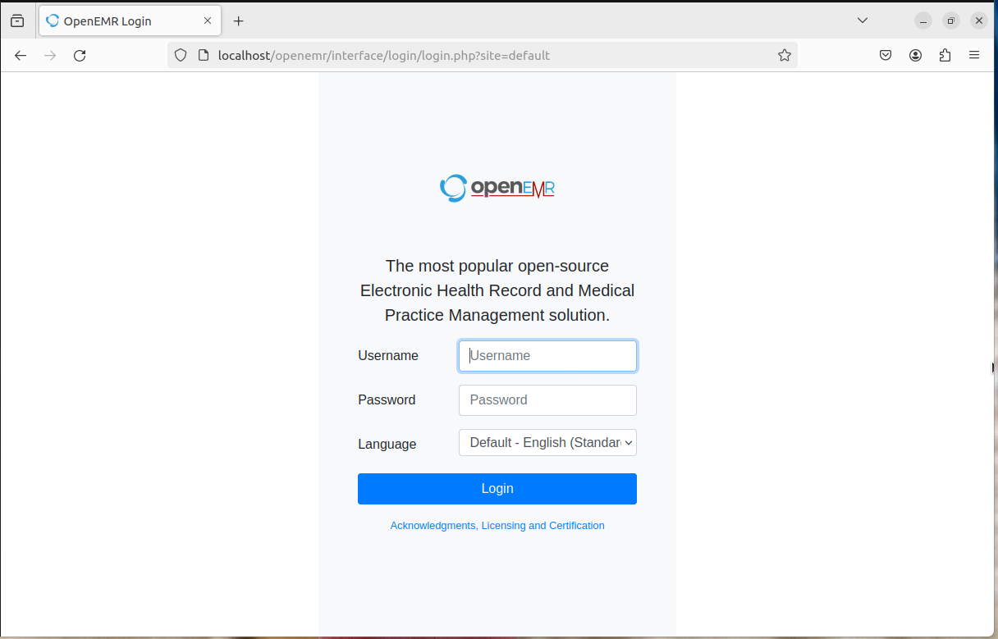
After Successful Installation

Slide 7
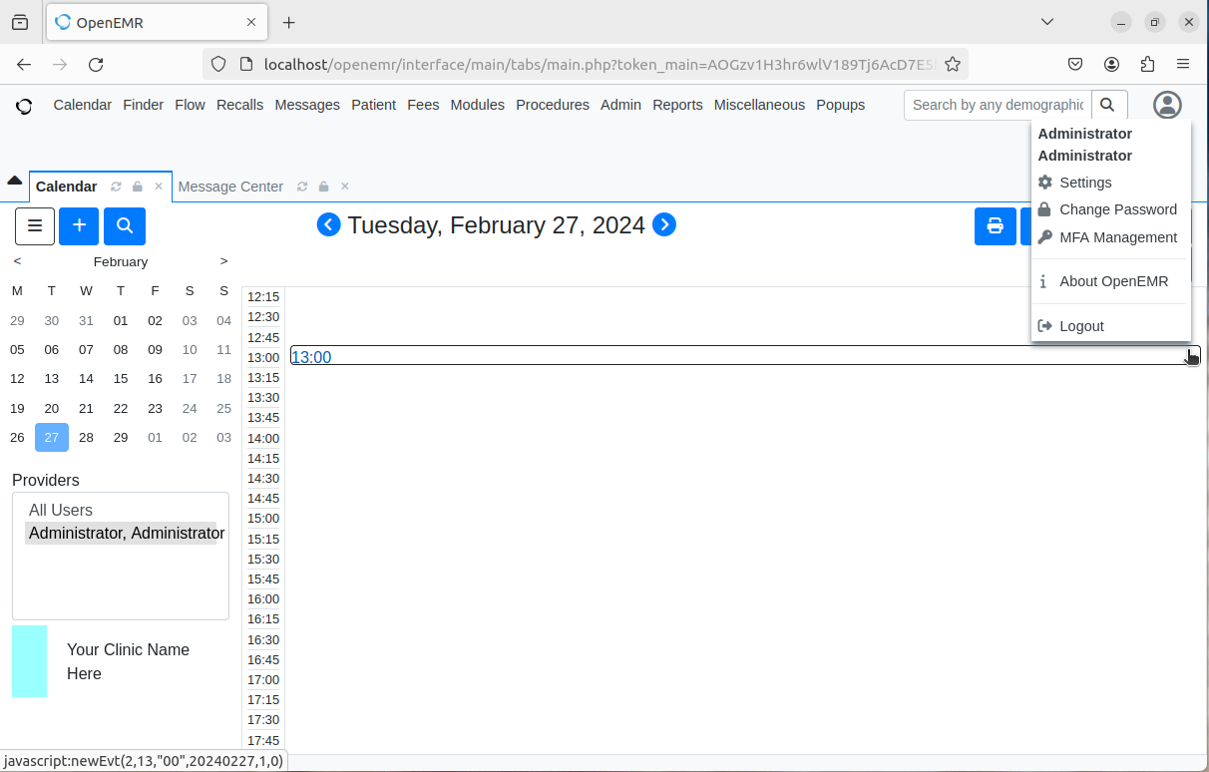
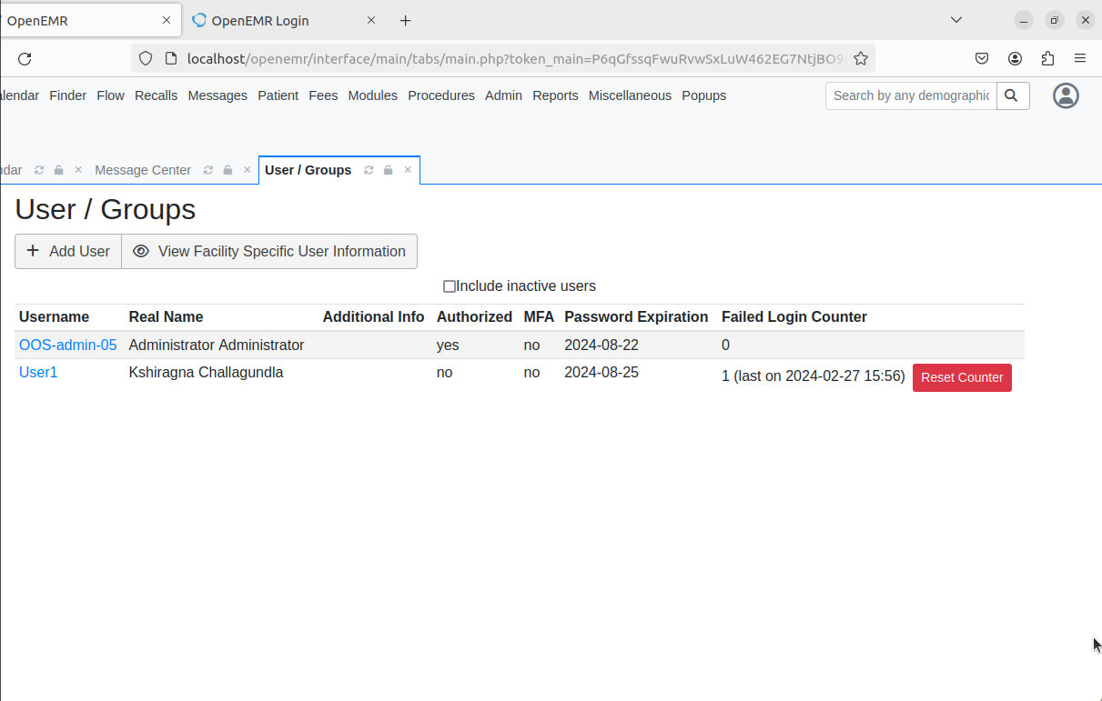
Test Case-1:
AC-2(8) Dynamic Account Management
To test the policy AC-2(8) we logged in as an Administrator and created a user as User1 based on the role defined as Front Desk.

Slide 8
Test Case:2
AC-9 Previous Logon Access Notification
Description: The information system notifies the user, upon successful logon (access) to the system, of the date and time of the last logon (access).
Implementation: We will set up an Email/SMS notification module to notify the user upon successful logon completion with the last logon date and time.
Email/SMS Settings -
For Email Services the following info is needed:
Notification Email Address - Where will the message come from
Email Transport Method - Select: SMTP, SENDMAIL or built in PHPMAIL
SMTP Server Hostname - email outgoing server host/ip
SMTP Server Port Number
SMTP User for Authentication - outgoing server user
SMTP Password for Authentication - outgoing server password
SMTP Security Protocol - Most newer servers use TLS, but some may use SSL. Not recommended to use NONE except for testing or connecting inside a firewall to an intermediary MTA (Mail Transferring Agent).
Email Service Provider:
Mailgun
Google Workspace SMTP Relay
Gmail personal accounts

Slide 9
2. BackEnd Notification -
bash$ crontab -e then put in the following lines:
* */1 * * * /var/www/html/openemr/modules/sms_email_reminder/cron_sms_notification.php
* */1 * * * /var/www/html/openemr/modules/sms_email_reminder/cron_email_notification.php
(note: make sure you adjust the path as per your configuration)
3. Log onto openEMR and navigate to Administration => Globals => Notifications.
4. In openEMR front end, under Patient/Client => summary (-page)=> Edit Demographics => Choices
In this section you will find two options:
1. Allow E-mail
2. Allow SMS.
5. Go to Administration => Other => Database.
Tools Used: We need to configure mercury mail in your xampp or separately to be able to send mails. Mercury Mail acts as a secure mail server on your local machine.

Slide 10
Test Case 3
CA-2(2): Specialized Assessments
Description: NIST SP 800-53 Rev 5's CA-2(2) relates to "Security Assessments for High-Impact Systems." You must carry out comprehensive and targeted assessments that target the high-impact components of your system in order to apply CA-2(2) controls for specialized assessments in the OpenEMR application.
Implementation
Defining the scope and objectives
Identifying the High Impact Assets
Define the Assessment Methods
Engage Security Experts
Performance of Penetration testing
Review of the Security Architecture
Secure Code Review
Documentation and Reporting
Remediation & Mitigation
Tools Used for Penetration Testing: Burp Suite, Nessus
Tools Used for Secure Code Review: SonarCube, Veracode

Slide 11
Test Case 4
RA-5: Vulnerability Monitoring and Scanning
Description: NIST SP 800-53 Rev. 5's RA-5 controls are related to "Vulnerability Scanning" measures. The OpenEMR application must regularly perform vulnerability scanning in order to find and fix any potential security flaws before implementing RA-5 restrictions. The following is a generic guide to RA-5 control implementation:
Implementation
Define Scanning Sco
How to Choose a Vulnerability Scanner
Set Up Scanning Parameters
Authentication for Deeper Scans
Conduct Frequent Scans
Integration with Change Management
Documentation of Scan Results
Set Priorities and Take Corrective Action
Retesting
Scan as much as possible automatically
Tools Used for Vulnerability Scanning: Nessus, Qualys, Tenable.io,Tenable.sc, OpenVas

Slide 12
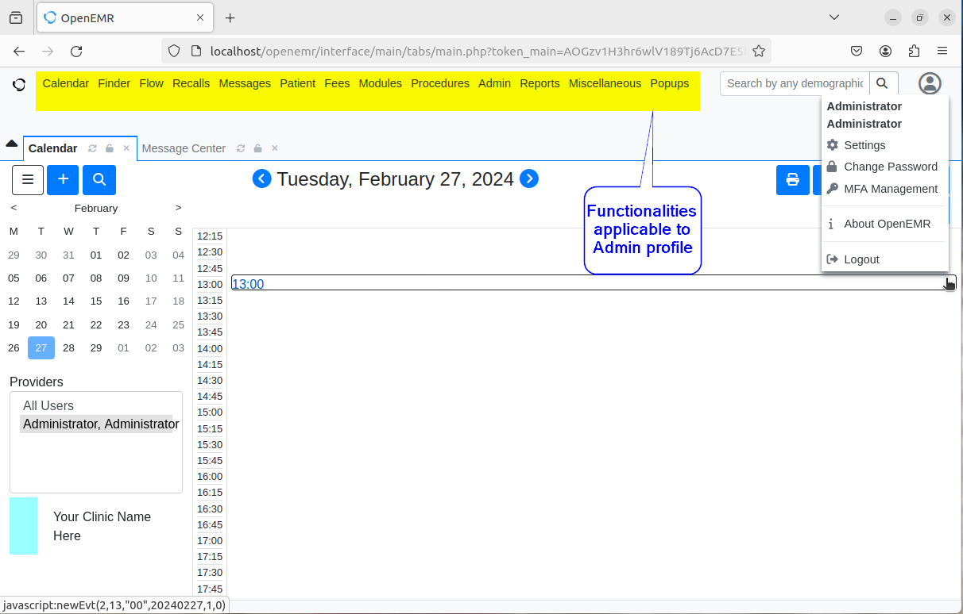
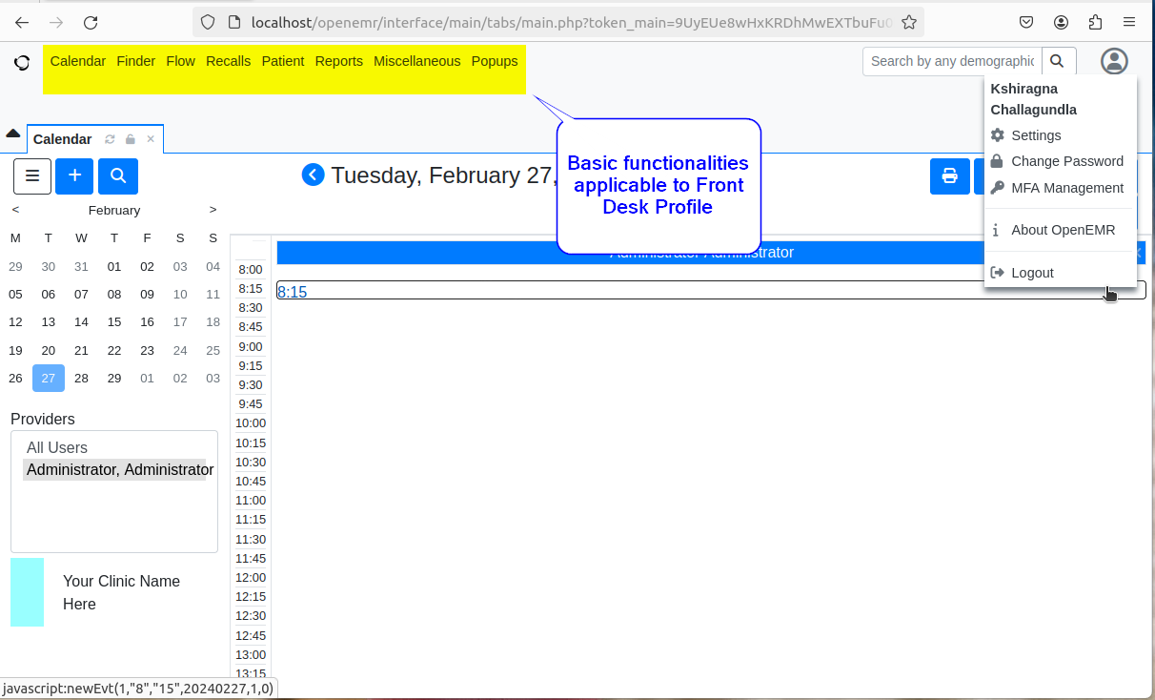
Test Case 5
AC-6(10): Prohibit Non-privileged Users from Executing Privileged Functions
Prevent non-privileged users from executing privileged functions.
To test this policy AC-6(10) while creating the user User1 having job responsibilities as Front Desk we ensure that he should not have access the same as Administrator.
The below screenshot shows the difference between the functionalities applicable to the Admin profile and the Front Desk profile.

Slide 13
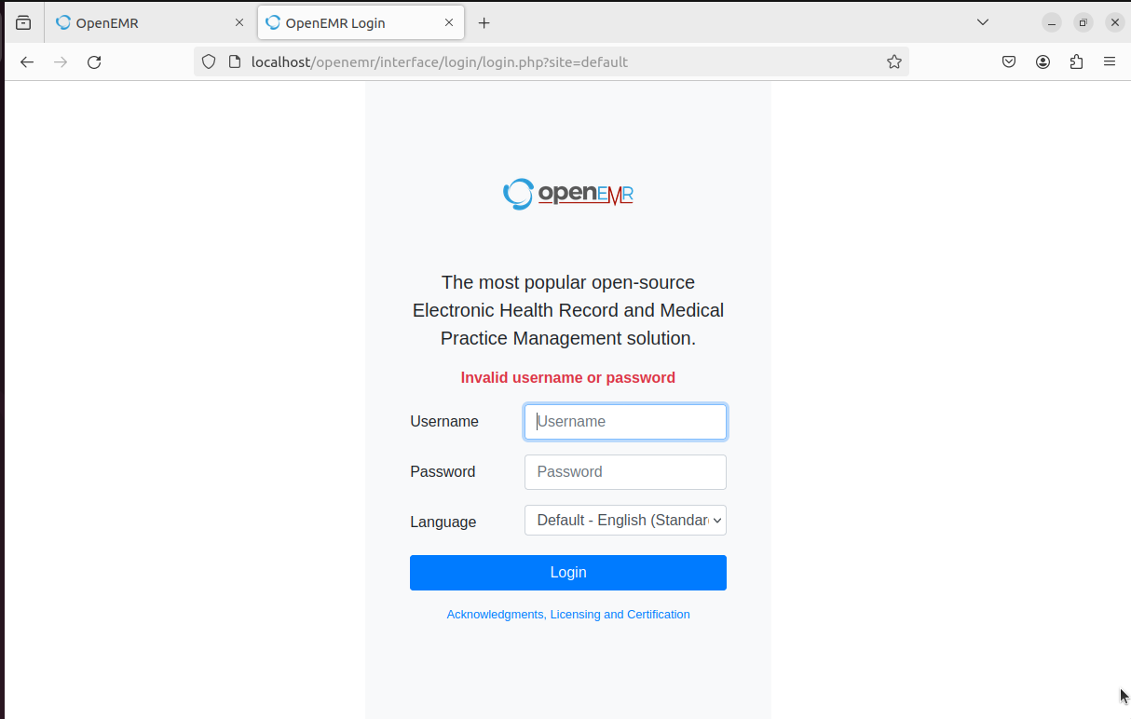
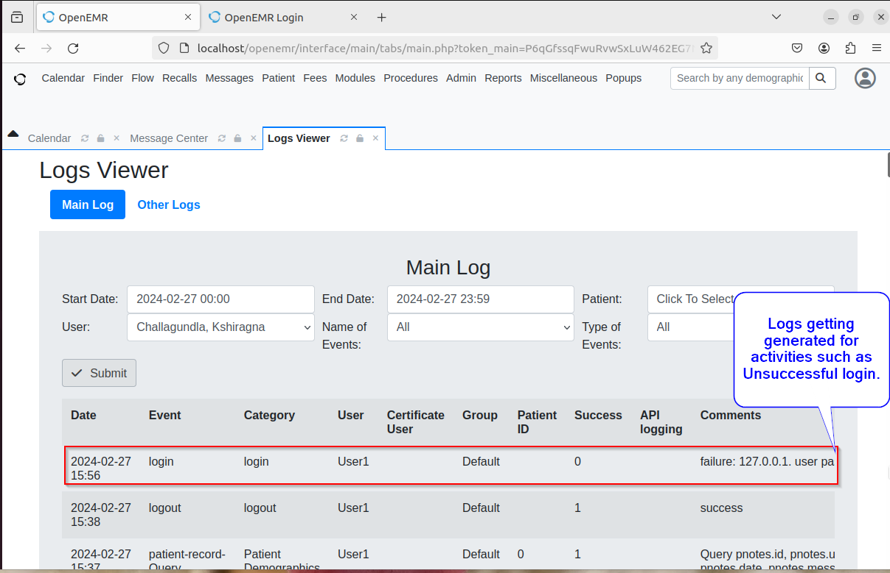
Test Case 6
AU-2: Event Logging
This ensures that the application generates the log for the activities that are carried out in the application.
To test this policy AU-2 we verified whether the application ensures to store the log for all the events.
The below screenshot shows the unsuccessful login attempt logs and activities that are carried out by the admin user.

Slide 14
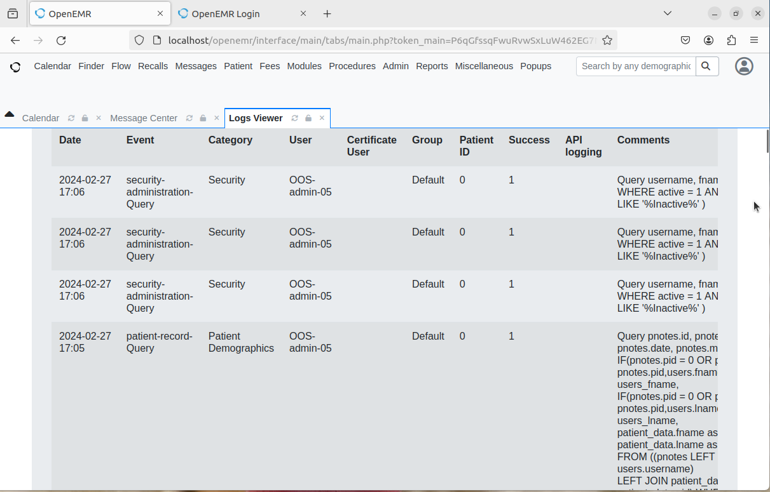

Slide 15
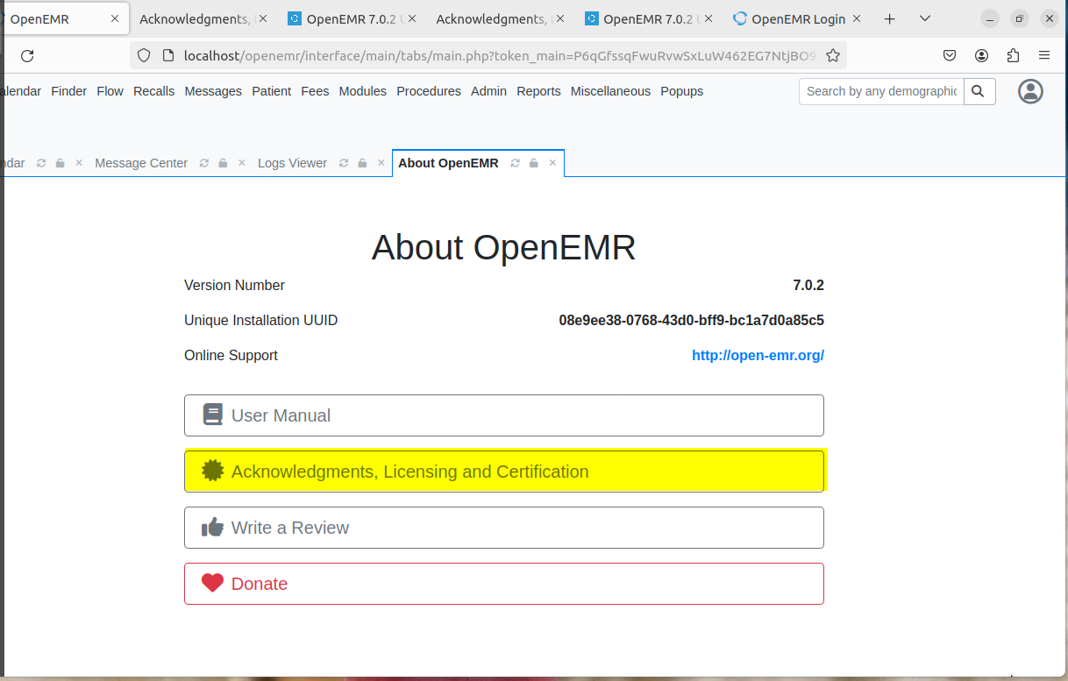
Test Case 7
CM-10: Software Usage Restrictions:
Implements policies and processes to govern the usage of software on information systems.
To test this policy CM-10 we verified whether the application has claimed all the acknowledgement, licensing, and certification information.
The below screenshot shows that it complies
with the required policy.

Slide 16
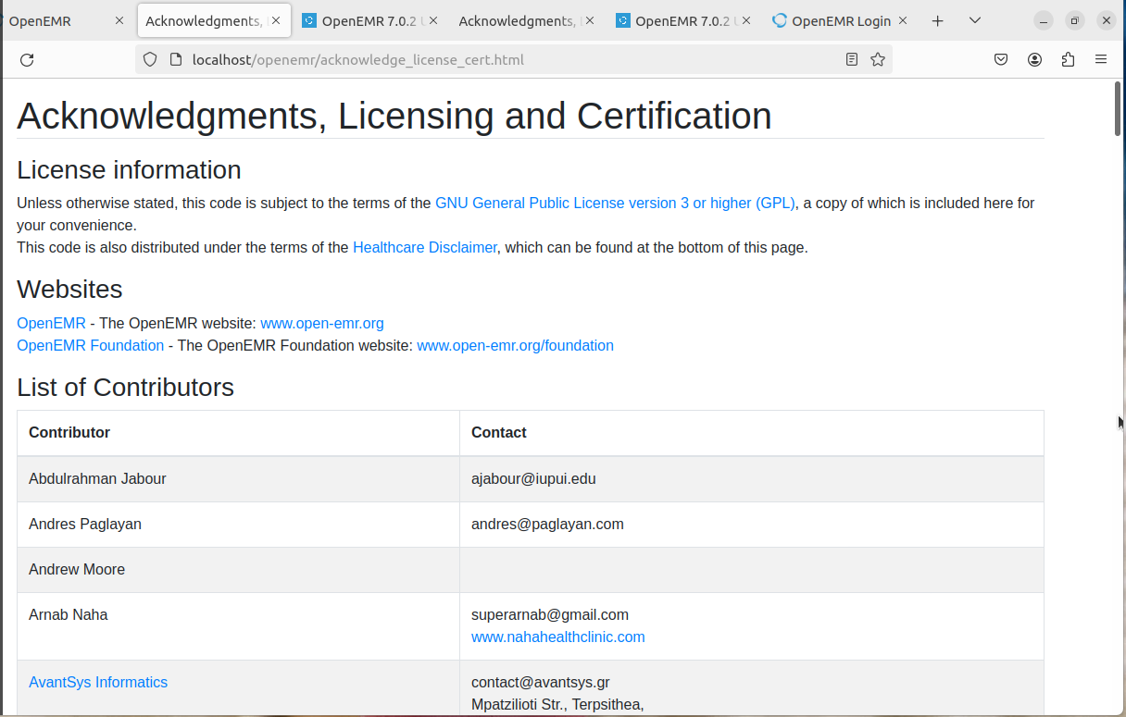
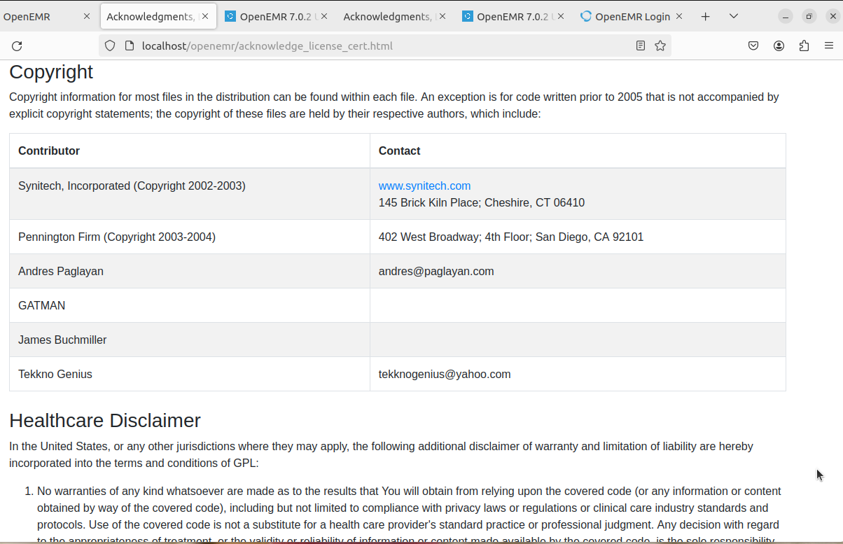

Slide 17
Test Case 8
PL-4: Rules of Behavior: Establish and provide to individuals requiring access to the system, the rules that describe their responsibilities and expected behavior for information and system usage, security, and privacy; Receive a documented acknowledgment from such individuals, indicating that they have read, understand, and agree to abide by the rules of behavior, before authorizing access to information.
To test this policy CM-10 we verified whether the application has described the user’s responsibilities and expected behavior for information and system usage, security, and privacy.
The below screenshot shows that it complies with the required policy.
The link to access the rules of behavior - https://www.open-emr.org/wiki/index.php/Access_Controls_Listing

Slide 18
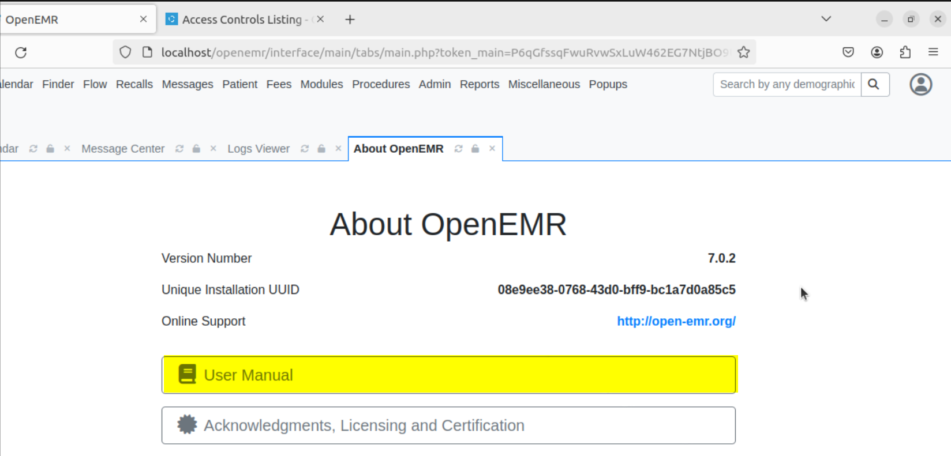
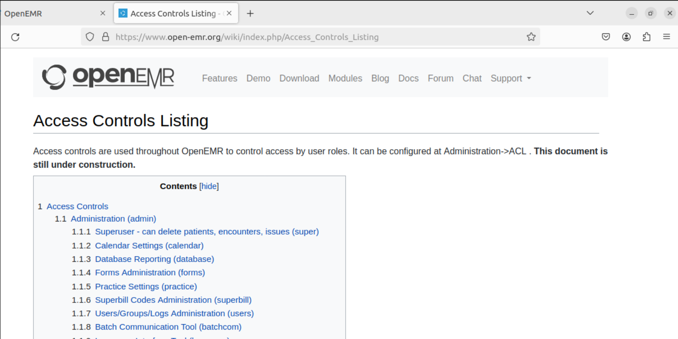

Slide 19
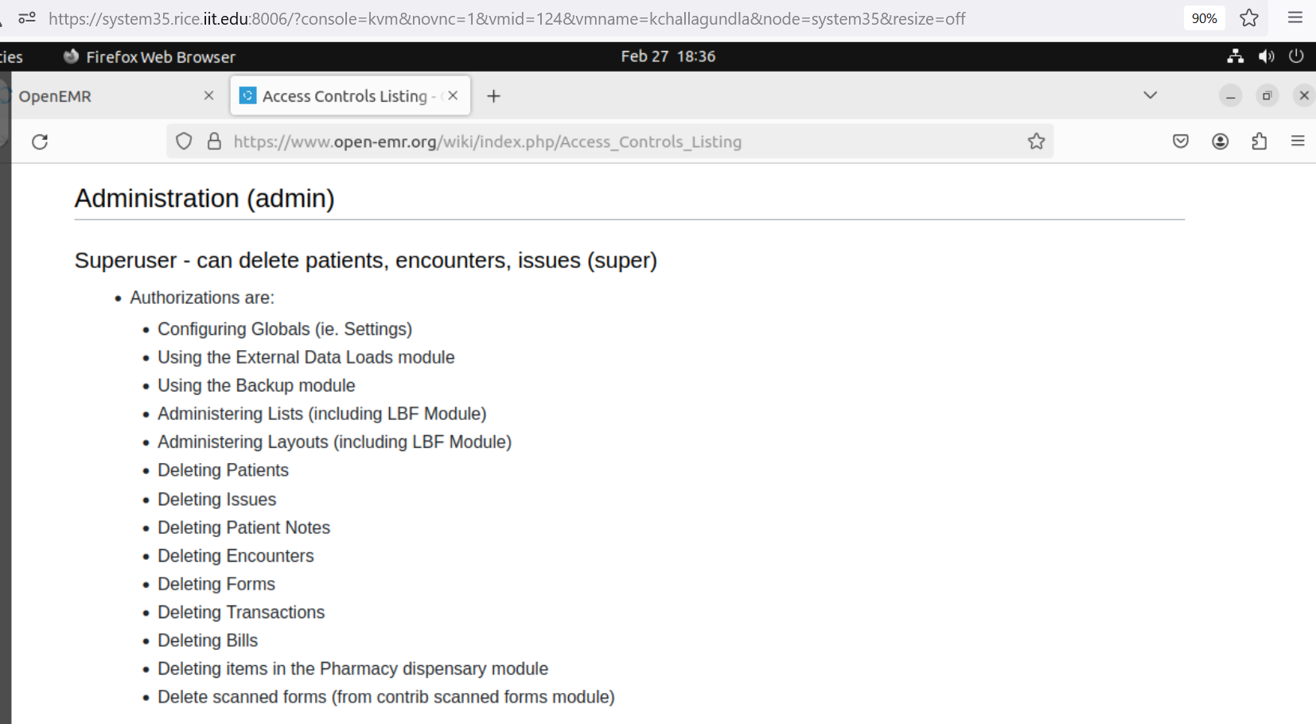

Slide 20

Office Ally is a package bundle of healthcare and record management software.
Office Ally is a software as a service (SAAS) package.
Office Ally software bundle include three main software packages
Service center
Practice mate
EHR 24/7
Service center is claims management software used to check for medical claims.
Practice mate is a practice management software.
EHR 24/7 is a electronic health record management software.

Slide 21

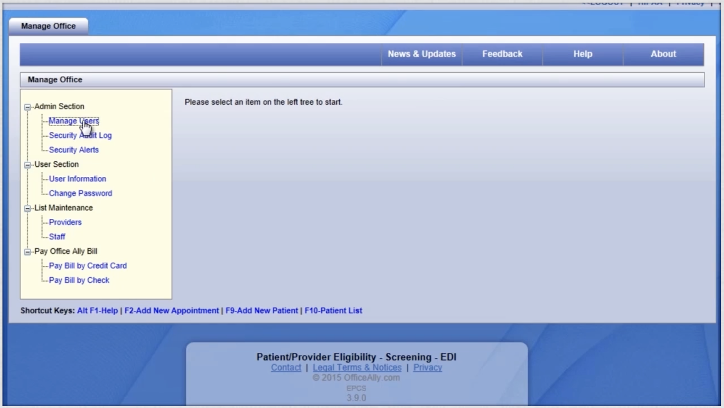
Account Management
There are three main accounts in Office ally
Administrator
Security administrator
Child
System logs data usage and logon attempts in security audit logs
System generated alerts are stored in security alerts
These information are available only to security administrators

Slide 22
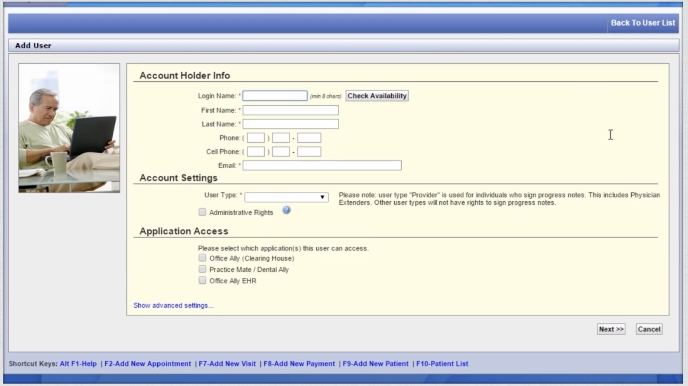
Admin has highest privilege but cannot create user accounts.
Admin privileges can be assigned to user during account creation with specific application access or universal access
Security admin will not have many privileges but they can create and manage user accounts.
Privileges are assigned based on roles.
Child users have the least privilege.

Slide 23
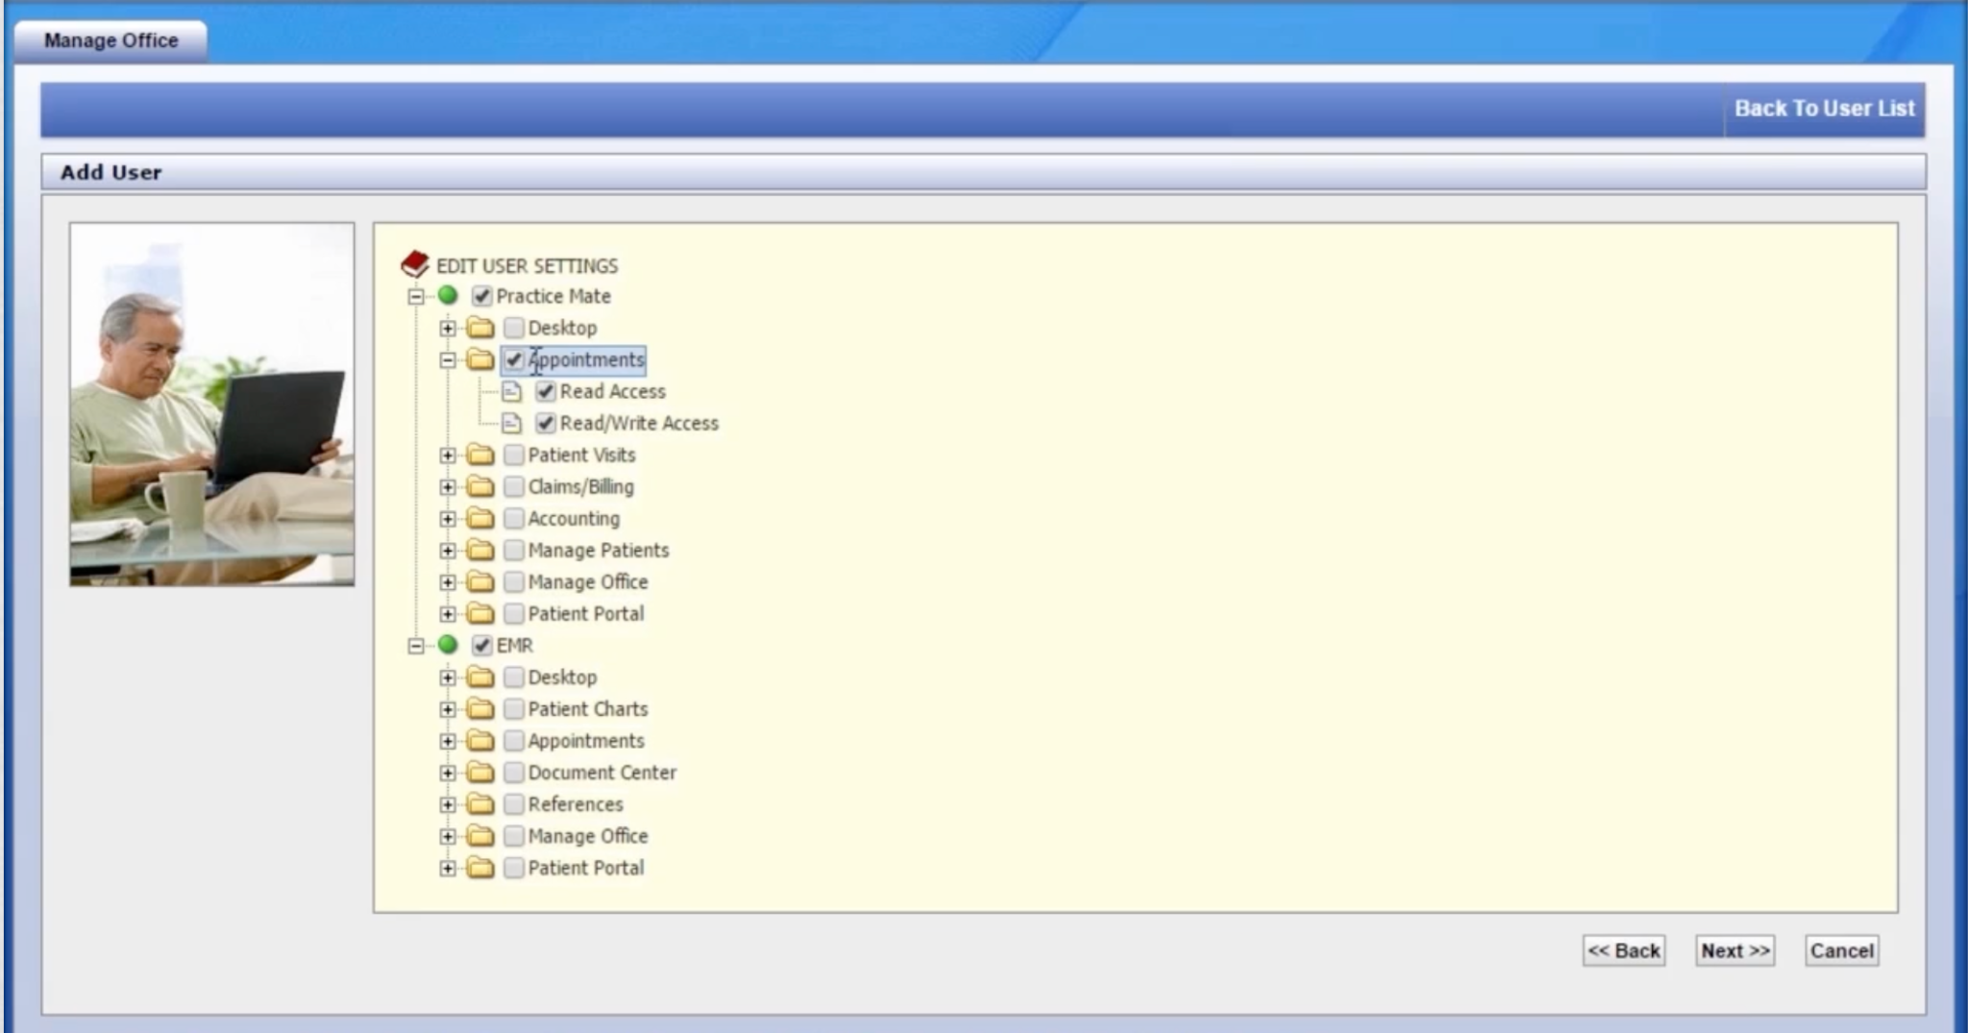
Access enforcement
The security admin assign privileges to the users based on application access
The privileges also include read access and read/write access.

Slide 24

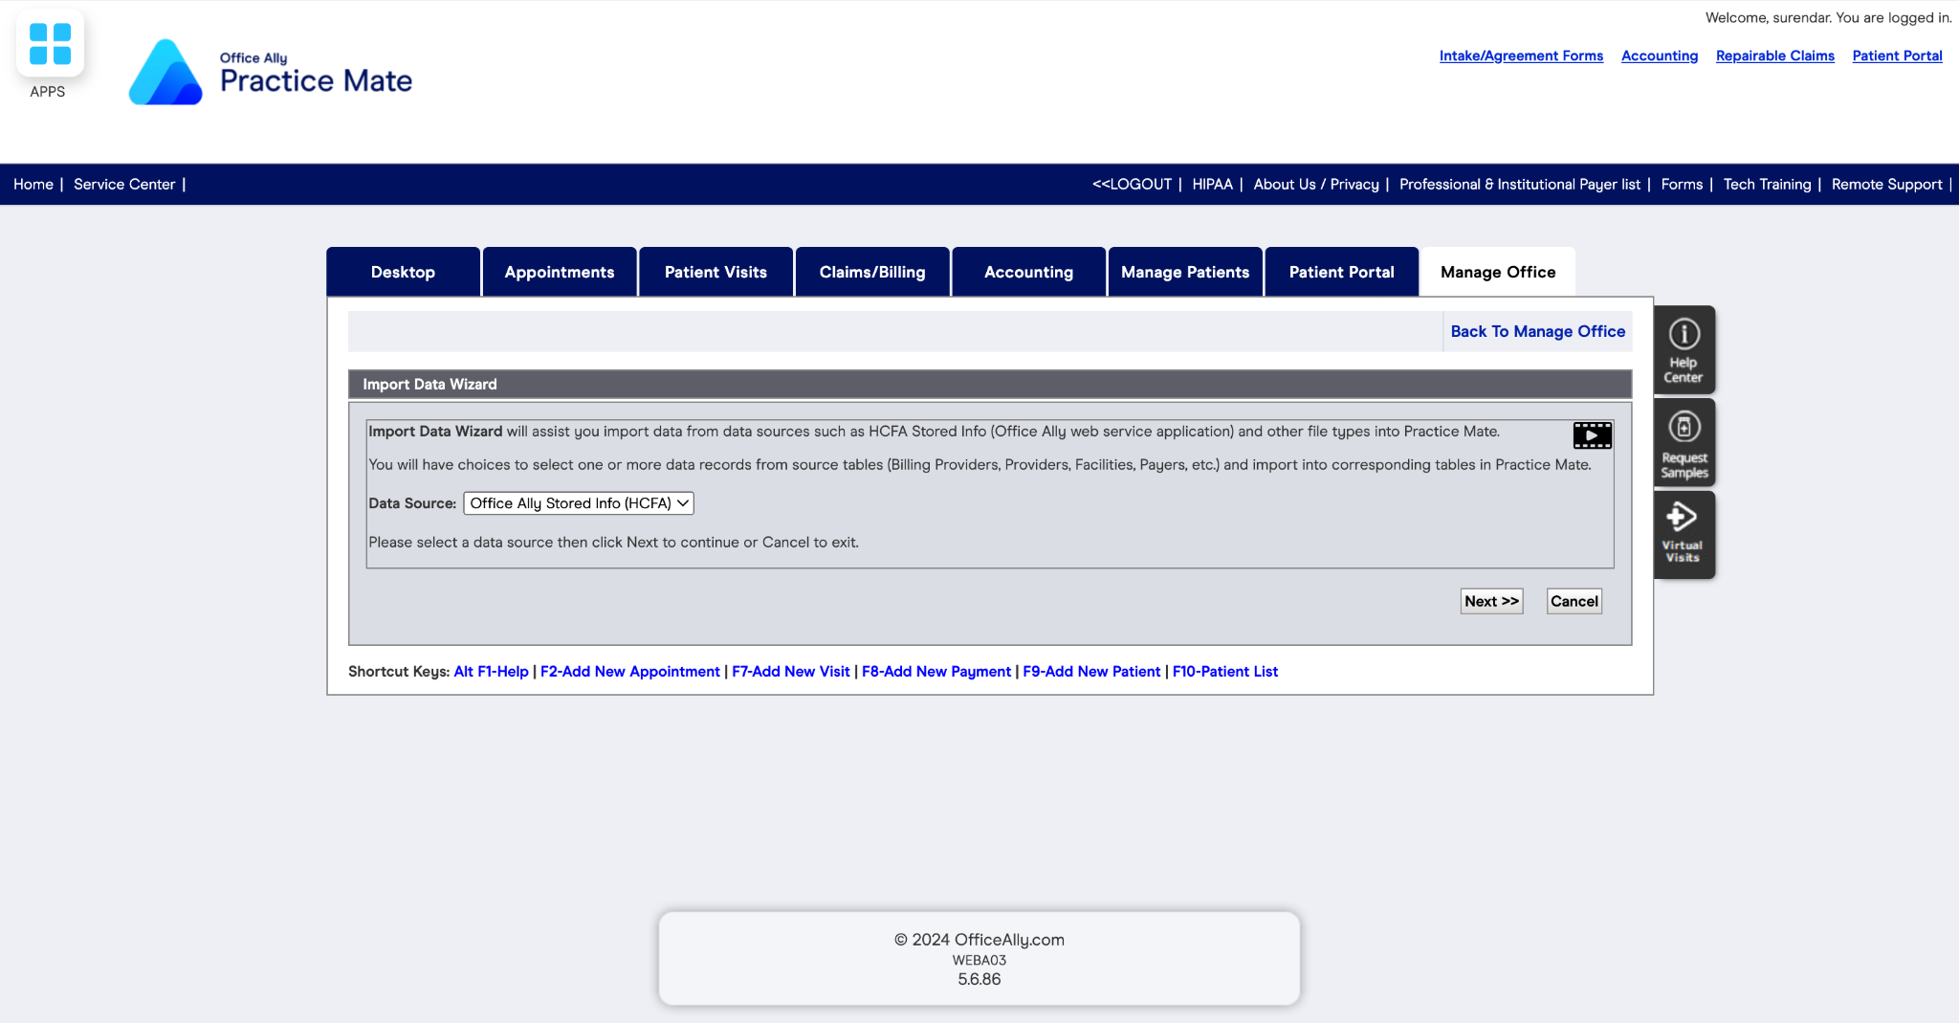
Users can create and maintain records within their authorized application
Users can also request for data from other users within the application
Data availability is classified into public, privileged and confidential
Public data is available to all the users in the application. Privileged data can be requested from users and confidential pertains to single user and patient.

Slide 25
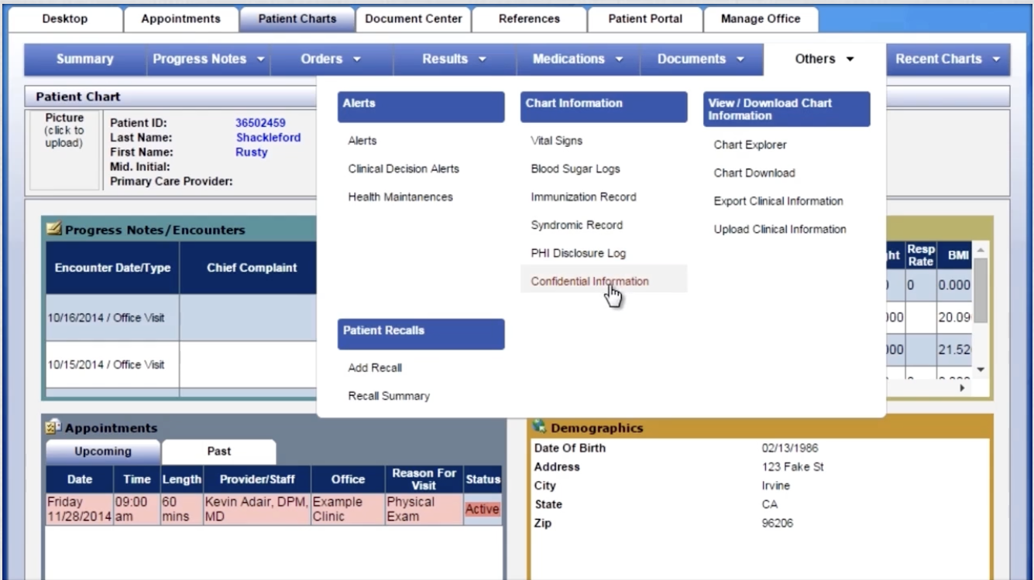
Users can create and maintain confidential information.
Confidential information can be additional information of a person or a new record.
The expiration date of a record is for 7 years from the date of creation.
The record can be exported in formats needed by the user.

Slide 26

OpenClinicGA
OpenClinic GA is an open source integrated hospital information management system covering management of administrative, financial, clinical, lab, x-ray, pharmacy, meals distribution and other data. Extensive statistical and reporting capabilities.
OpenClinic GA is a bundled package of healthcare and record management software.
The OpenClinic GA software bundle includes three main software packages:
OpenClinic Service Center
OpenClinic Practice Mate
OpenClinic EHR 24/7
OpenClinic GA offers a user-friendly interface and customizable features to meet the unique requirements of different healthcare settings.

Slide 27
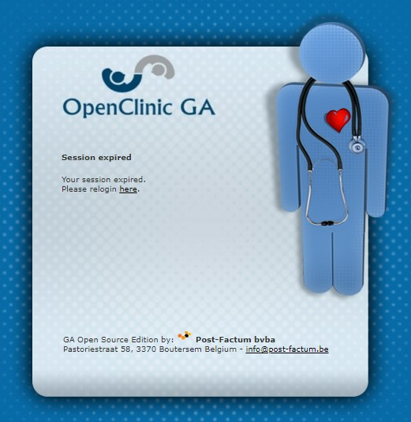
AC-11: Session Lock: Automatically locks user sessions after a period of inactivity.
Temporarily suspends access without terminating the session.
Users must reauthenticate to unlock the session.
Balances security and usability.
AC-12: Session Termination: Automatically terminates user sessions after a period of inactivity.
Logs the user out of the system entirely.
Requires users to log back in to continue their work.
Enforces security policies and minimizes unauthorized access risk.
Under this control, when a logged-in user is not performing any activity, the system considers the login as idle and terminates the access. This results in the session expiring.

Slide 28
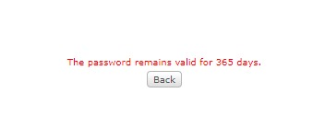
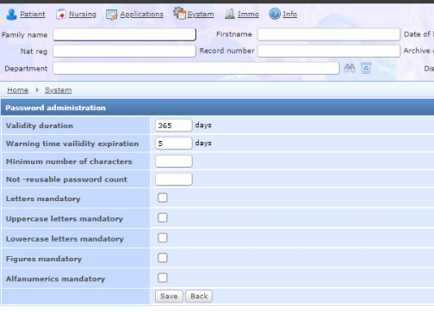
IA-5(1): Authenticator Management - Password-Based Authentication:
This control requires organizations to enforce password expiration by specifying maximum password lifetime restrictions. It ensures that passwords expire after a defined period, prompting users to change them periodically.
Password expiration is a fundamental aspect of password management strategies, aligning with best practices to maintain strong authentication mechanisms and mitigate the risk of unauthorized access to sensitive information systems.

Slide 29

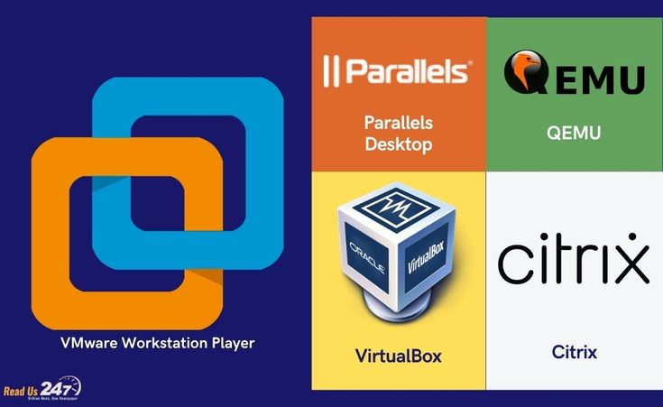
CM-14 Signed Components: Prevent the installation of without verification that the component has been digitally signed using a certificate that is recognized and approved by the organization.
Software and firmware components prevented from installation unless signed with recognized and approved certificates include software and firmware version updates, patches, service packs, device drivers, and basic input/output system updates.
Organizations can identify applicable software and firmware components by type, by specific items, or a combination of both. Digital signatures and organizational verification of such signatures is a method of code authentication.

